Slide 1

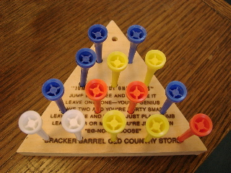
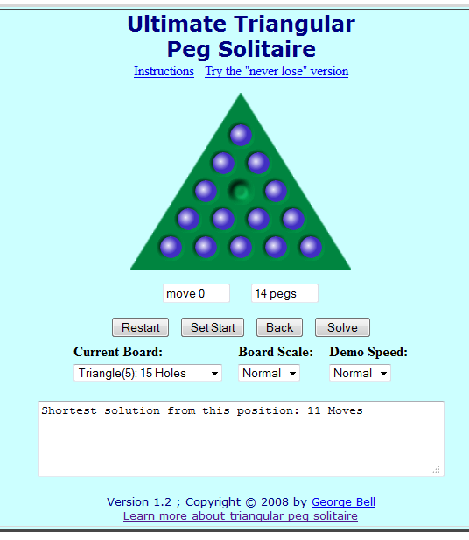
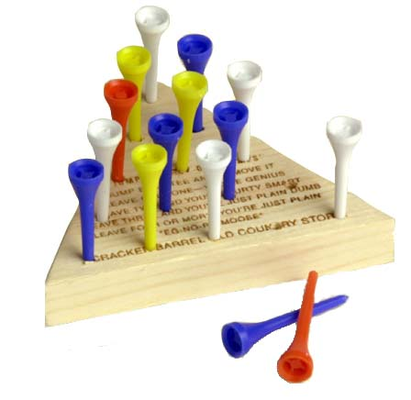
Crackle Barrel Project
Presented by:
Iwan Njoto Sandjaja

Slide 2
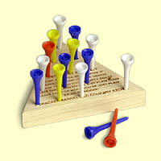
Random Search
Experiment 1 :
  Success = 1; Fail = 15 Time 3.31s
Experiment 2 :
  Success = 1; Fail = 36 Time 1.06s
Experiment 3 :
  Success = 1; Fail = 60 Time 0.54s

Slide 3
Exhaustive Search (Backtrack)
Success = 1550; Fail = 136296
P(Success) = 0.0113723073311029
Time 3.29 seconds
If use checker rules the shortest moves is 11 moves
13 moves = 538
12 moves = 704
11 moves = 308

Slide 4
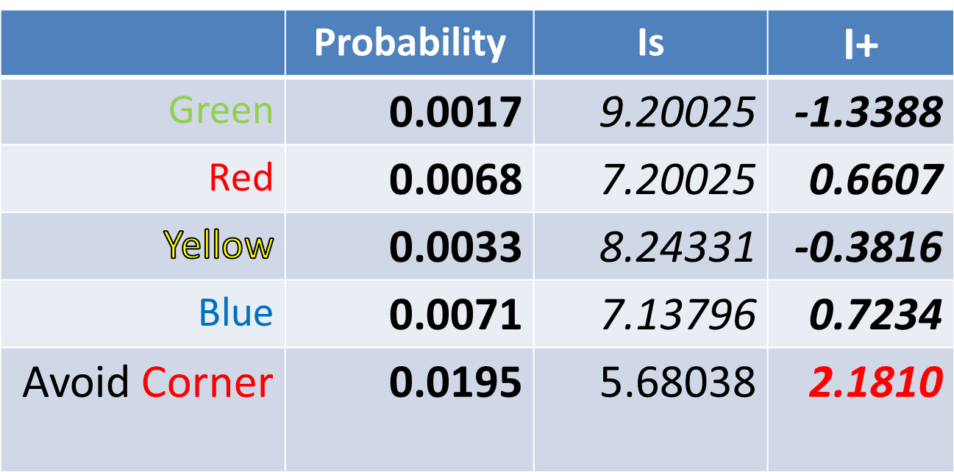
Random Search
P[Rand] = 0.0043 I_{Ω} = 7.86145

Slide 5
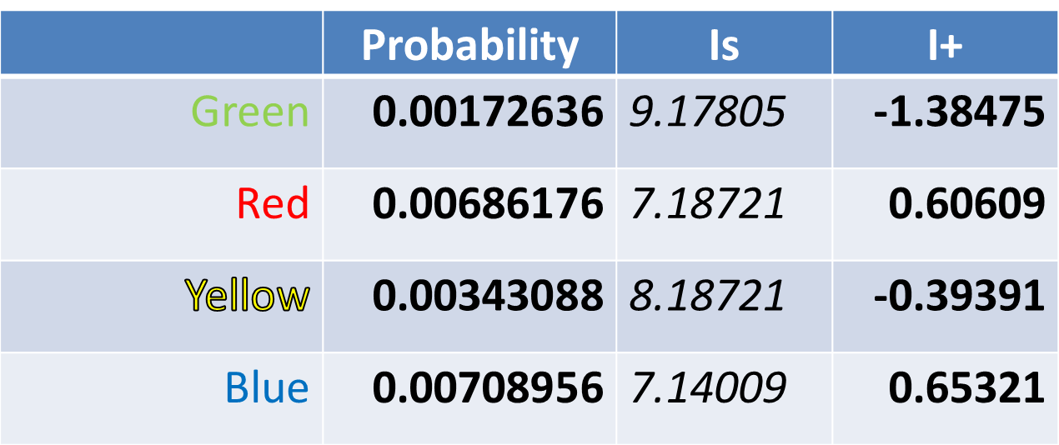

Exhaustive Search (Backtrack)
P[ALL] = 0.00450789 I_{Ω} = 7.7933

Slide 6
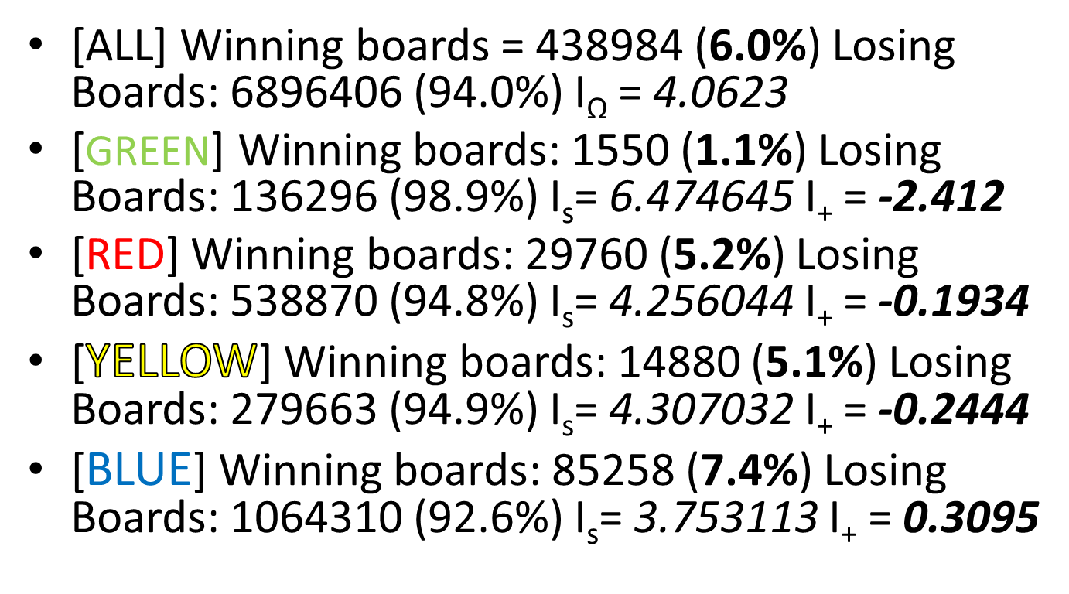
Exhaustive Search (Backtrack)

Slide 7
References
http://www.cs.virginia.edu/pegboard/
http://www.madoverlord.com/projects/crackerbarrel.t
http://www.danobrien.ws/PegBoard.html
http://home.comcast.net/~gibell/pegsolitaire/CBTips.html

